Slide 1
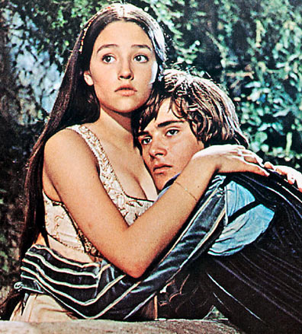
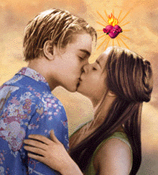
Romeo and Juliet

Slide 2
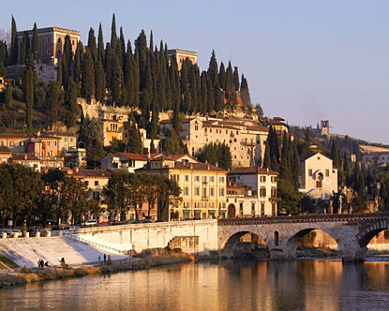
Two households…

Slide 3
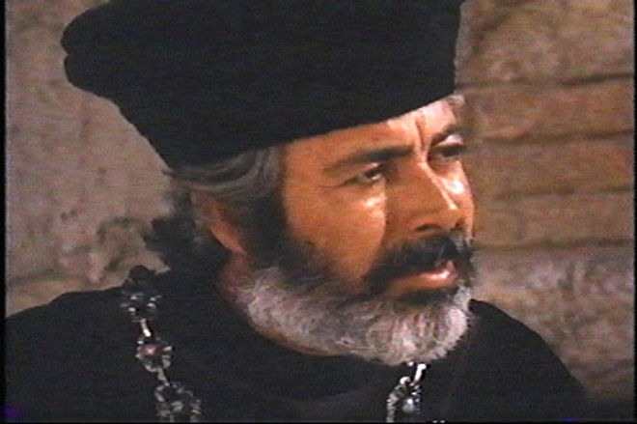
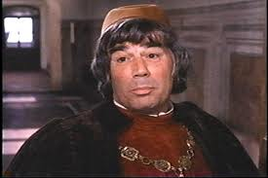
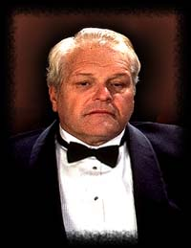
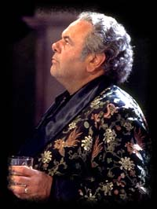
Both alike in dignity…

Slide 4
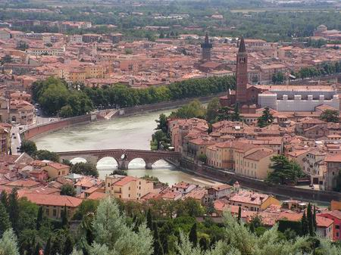
In fair Verona,
where we lay our scene…

Slide 5
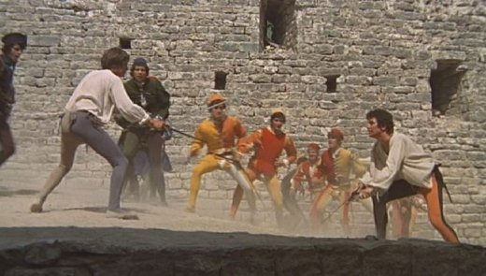
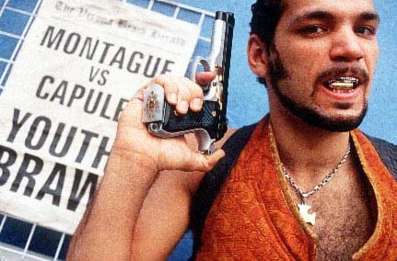
From ancient grudge
break to new mutiny…

Slide 6
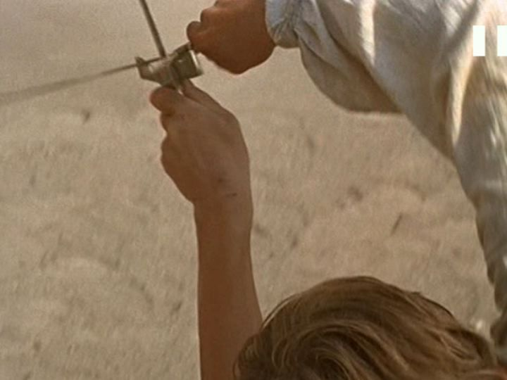
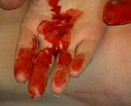
Where civil blood
makes civil hands unclean.

Slide 7
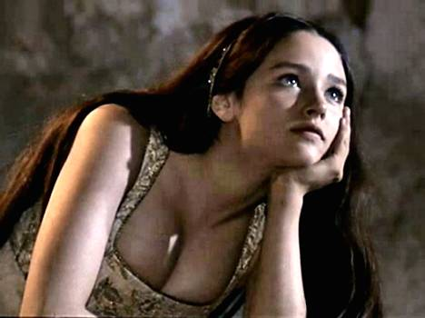
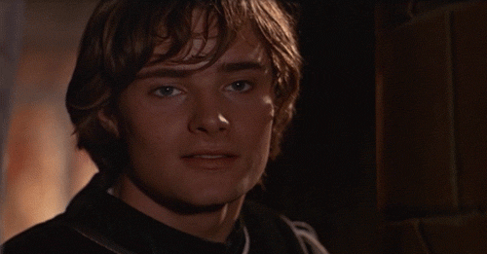
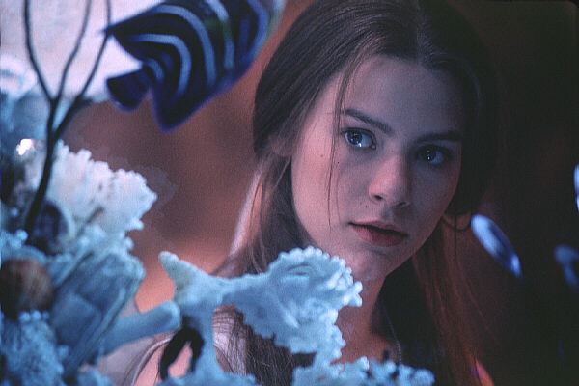
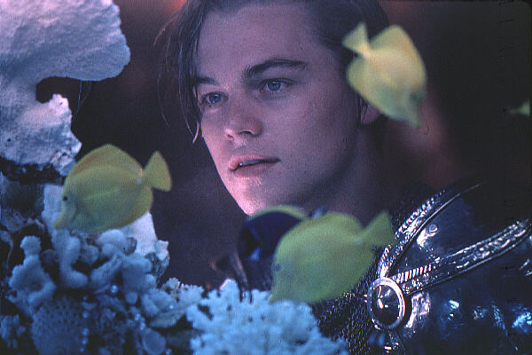
From forth the fatal
loins of these two foes,

Slide 8
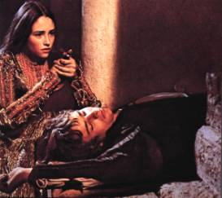
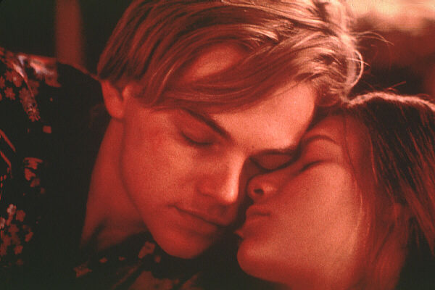
A pair of star-cross’d
lovers take their life.

Slide 9
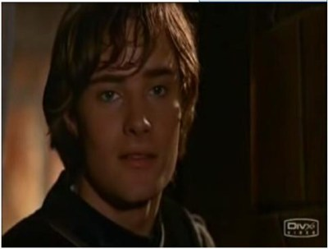
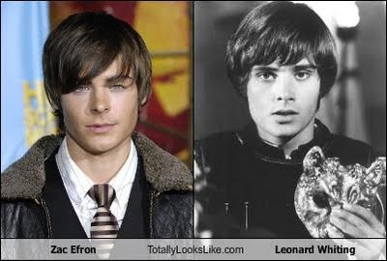
Romeo
Is a Montague
18 years old
Cute, smart, sensitive
Impulsive and immature
Romantic heart
EMO
He doesn’t care about the feud

Slide 10
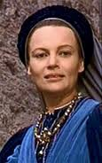
Lady Montague
Romeo’s Mom
Dies of grief for love of her son

Slide 11
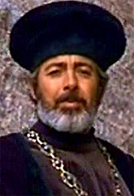
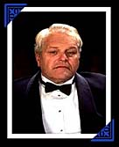
Lord Montague
Romeo’s dad
Worries about Romeo’s sadness
Patriarch (head man) of the Montagues
Loves his son

Slide 12
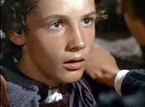
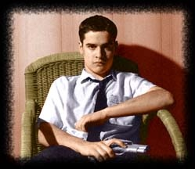
Balthasar
Romeo’s servant
He goes to tell Romeo that Juliet is dead (he doesn’t know that it is a fake death)

Slide 13
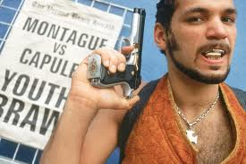
Abraham or Abram
Lord Montague’s servant
Fights Sampson and Gregory in the beginning

Slide 14
Benvolio
Romeo’s cousin & friend
Tries to break-up fights. Keep the peace.
Counsels Romeo about love and make him feel better.

Slide 15
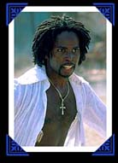
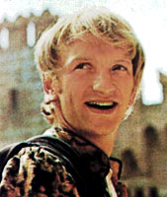
Mercutio
Related to the prince
Good friends W/ Romeo
Bad temper
Doesn’t like emotional people
Believes love is about the physical contact and nothing else.

Slide 16
Juliet
-is a Capulet, 13 yrs old
Begins as a naïve child,
She doesn’t have as much freedom as Romeo b/c she is a girl
SO she sneaks around to see Romeo
She totally trusts Romeo
Juliet is very close with the nurse.

Slide 17
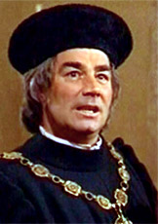
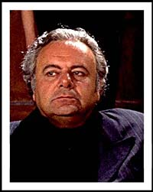
Lord Capulet
Juliet’s dad
He truly loves Juliet, but does not know her feelings and dreams
Bad temper when things don’t go his way
He commands respect and propriety
Patriarch of the Capulets

Slide 18
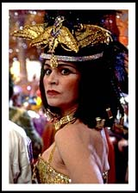
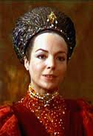
Lady Capulet
Juliet’s mom
Ineffectual mother- relies on the nurse to “mother” Juliet
She married young, had Juliet around age 14, and is eager for her to marry Paris

Slide 19
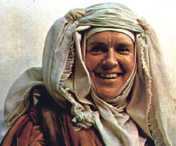
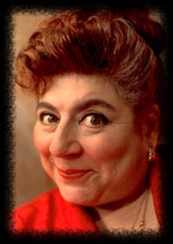
Nurse
Has cared for Juliet since she was born
Vulgar, long-winded, loyal and a confidante to Juliet
At end though, they have a falling-out over Romeo

Slide 20
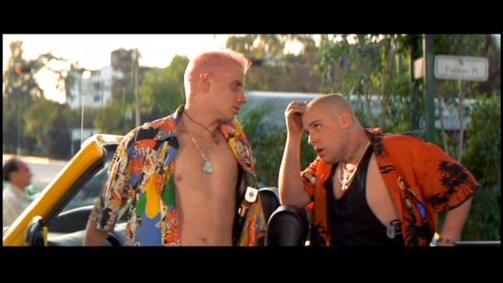
Gregory & Sampson
Servants to the Capulets
Start a fight w/ Montagues at the beginning of the play

Slide 21
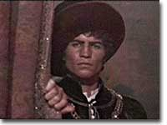
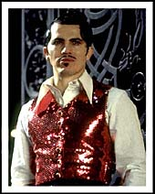
Tybalt
Juliet’s cousin
Vain, fashionable, very into proper etiquette, prideful
He is well-trained in sword fighting and someone to fear
He loathes Montagues
“Cat”

Slide 22
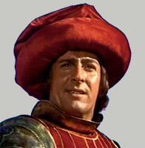
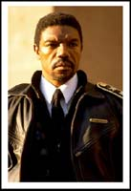
Prince Escalus
Prince of Verona
He is concerned with maintaining public peace
Related to Mercutio and Paris

Slide 23
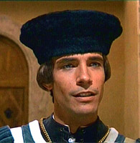
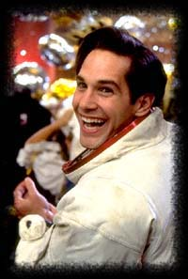
Paris
Related to the prince
Preferred by the Capulets to marry Juliet
He treats Juliet inappropriately after Capulet says he can marry her.

Slide 24
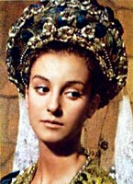
Rosaline
The woman who Romeo is obsessed with at the beginning of the play.

Slide 25
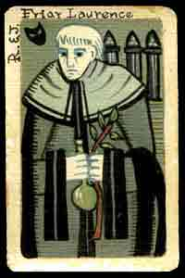
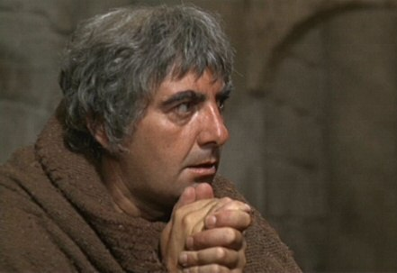
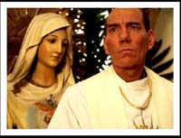
Friar Lawrence
Friend to Romeo and Juliet
Kind, civic-minded
Secretly marries R & J in hopes that their marriage will end the feud.
He is a Catholic holy man and also familiar with potions and herbs.

Slide 26
Prologue to Romeo and Juliet
Two households, both alike in dignity, In fair Verona, where we lay our scene, From ancient grudge break to new mutiny, Where civil blood makes civil hands unclean. From forth the fatal loins of these two foes A pair of star-cross'd lovers take their life; Whose misadventured piteous overthrows Do with their death bury their parents' strife. The fearful passage of their death-mark'd love, And the continuance of their parents' rage, Which, but their children's end, nought could remove, Is now the two hours' traffic of our stage; The which if you with patient ears attend, What here shall miss, our toil shall strive to mend.

